Slide 1


Term Project Presentation
SIRE 504 Programming in Bioinformatics
Bowornpol Nuim
Master’s degree student 6437932 SIMB/M
Naphat Sanguansakpakdee
Master’s degree student 6437931 SIMB/M
Mattika Thaweesuvannasak
Master’s degree student 6436307 SIBB/M
1

Slide 2
Project Timeline
Merge all features to develop via GitHub
Recheck error in our program
Understand the input information (FASTQ)
FASTQ → CSV
Term project presentation
Feature development
Create the package [argparser()]
Report: HTML
Oct 28, 2021
Nov 2 – 25, 2021
Nov 26, 2021
Dec 2, 2021
2

Slide 3
Team collaboration
Approach
Slack
Online meeting
Via google meet, zoom
GitHub
On-site meeting
Advantage
Clear assignment of work (feature development) to each members.
Good time management.
Availability for a meeting anytime.
Easily collaborate with others, by letting other members contribute to your projects or you contributing to member’s projects.
3

Slide 4


Team collaboration
Challenge
GitHub: It’s quite complex system and spend the time a lot for understanding.
HTML: It's quite our first time to create the html report.
Plotly python package (visualization): It has a lot of the form to produce the results.
Solution
Meeting and consults with our members.
Consults with professor directly via chat box in slack, Q&A session, and on-site.
4

Slide 5
Our Program
5

Slide 6
Our Program
read
Sub-package
readFastq
Module
FASTQsum
Program
fqToCsv()
report
Package
summary
Sub-package
feature
Module
fastqsum.exe
lenSum()
scSum()
main.py
“./fastqsum sum –r [filelocation]” → fqToHtml()
“./fastqsum sum –c [filelocation]” → fqToCsv()
scVsLen()
csvToHtml()
Input: FASTQ
Output: HTML report
fqToHtml()
6

Slide 7
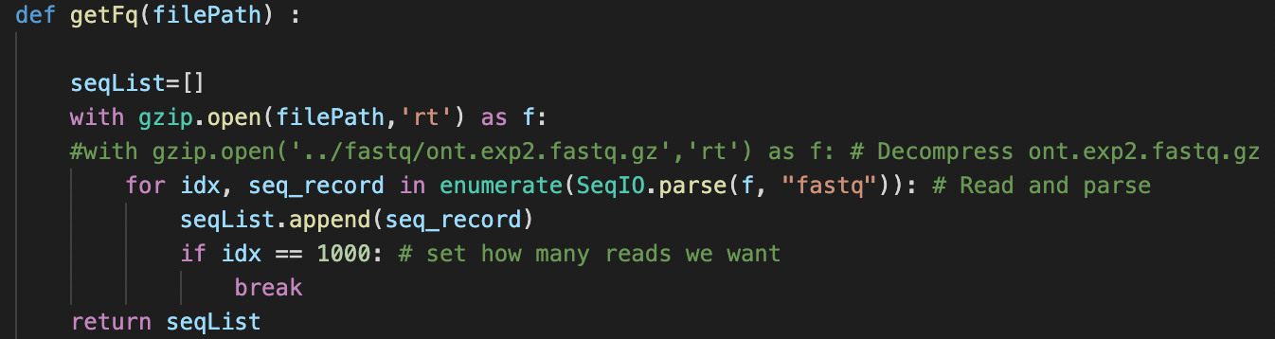
Our Program
Input
FASTQ file (.gz)
7

Slide 8
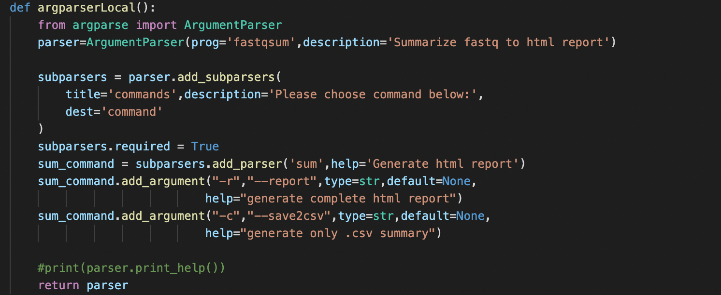
Our Program
Parameters
-r, --report (option to html report)
-c, --save2csv (option to only .csv summary)
8

Slide 9
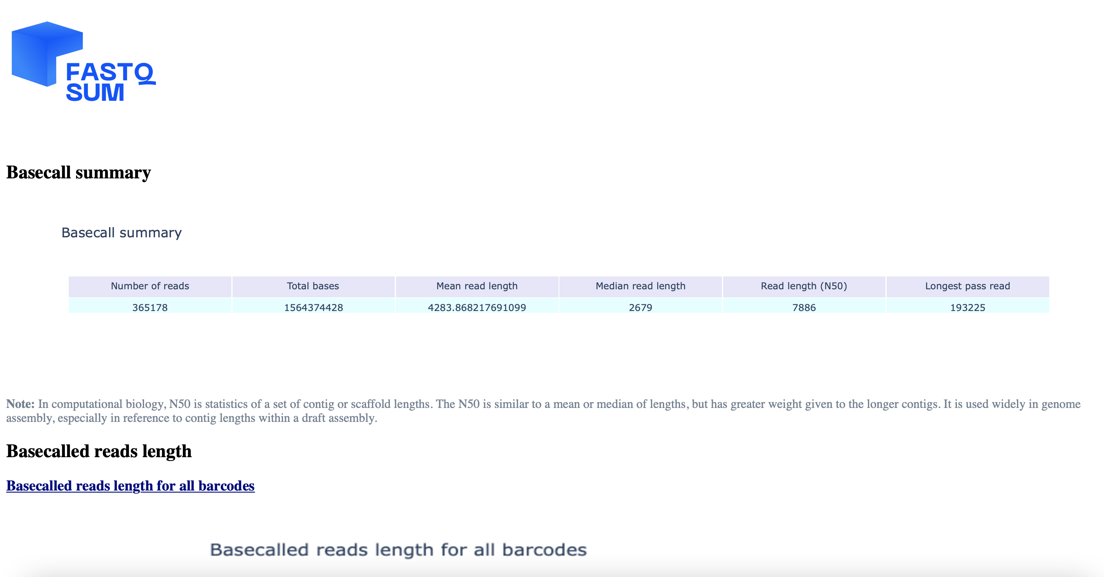
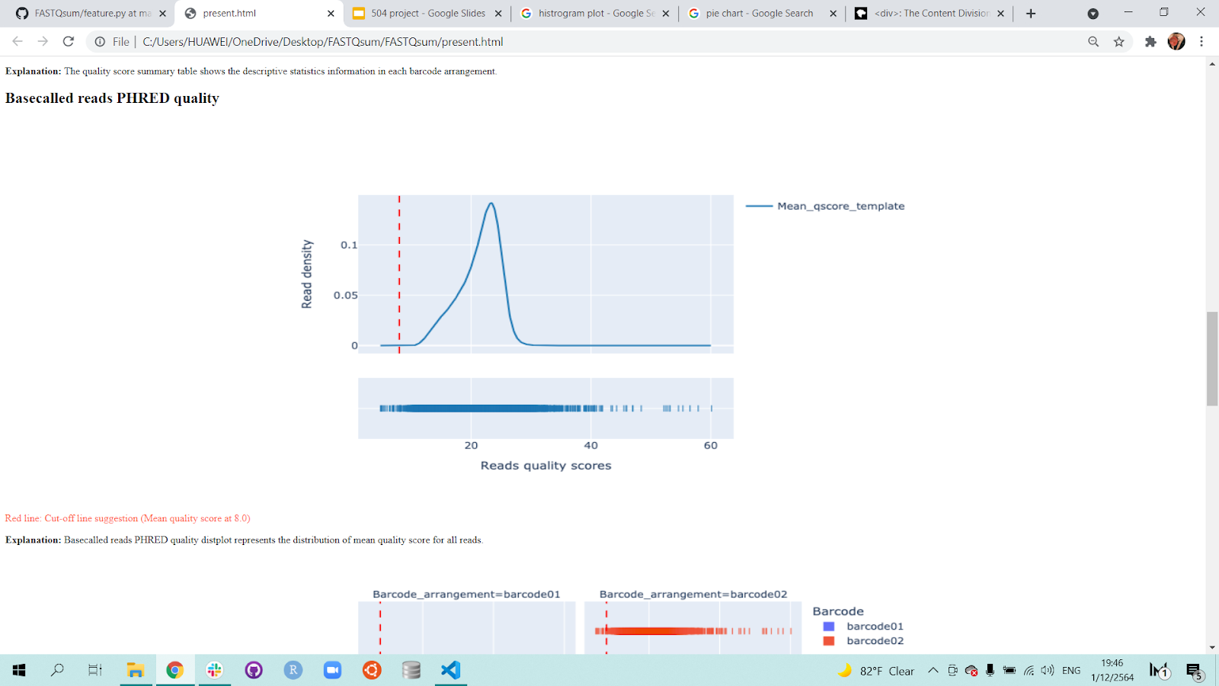
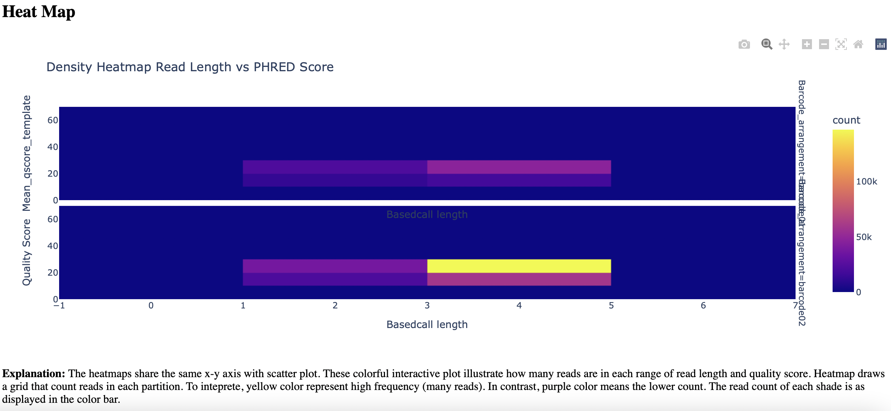
Our Program
Output
HTML report
9

Slide 10
Functions
In feature module
10

Slide 11
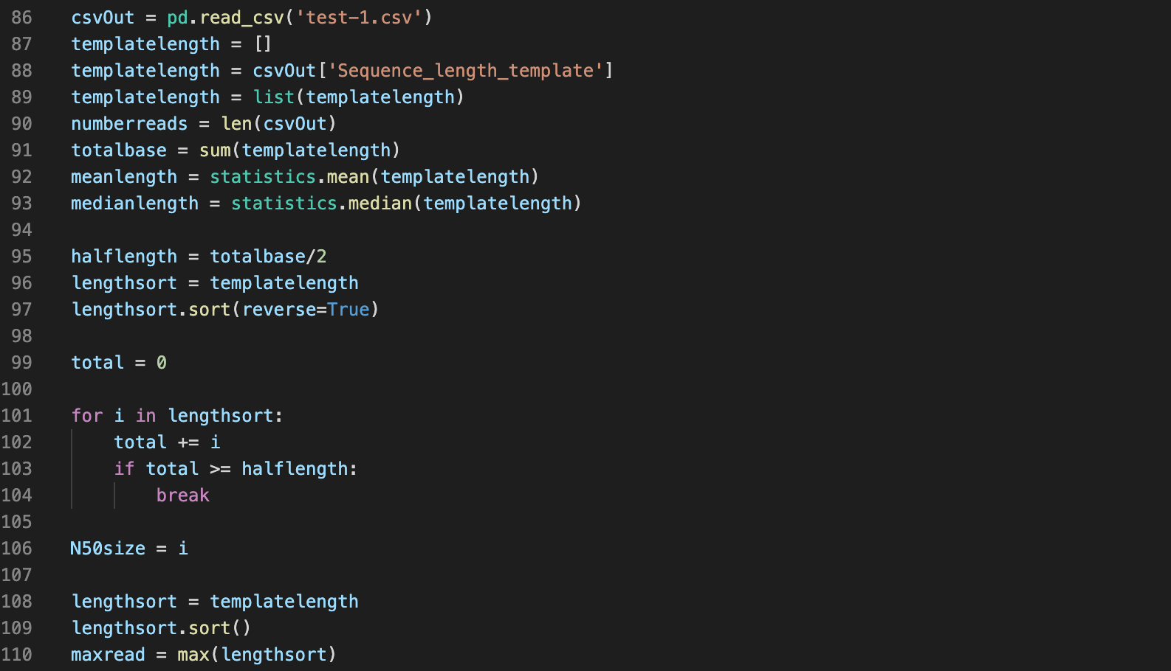
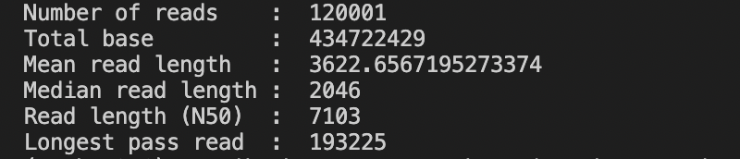
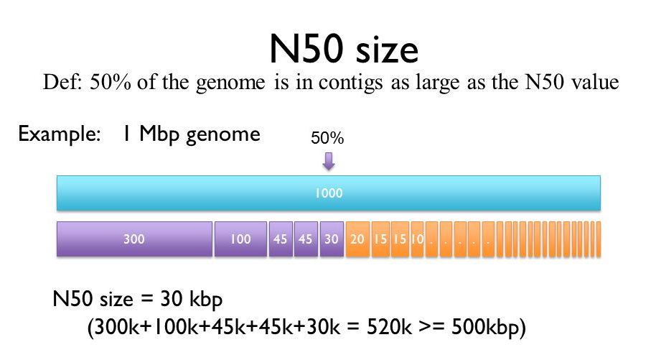
Part 1: Calculate all values, including number of reads, total base, Mean read length, Median read length, Read length (N50), and Longest pass read
01
Read Length
By Mattika
Python code:
Output:
11

Slide 12
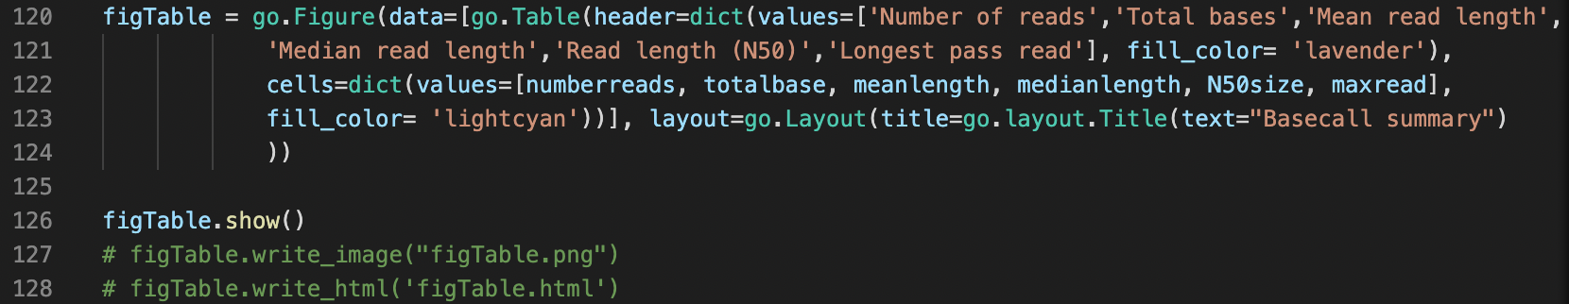
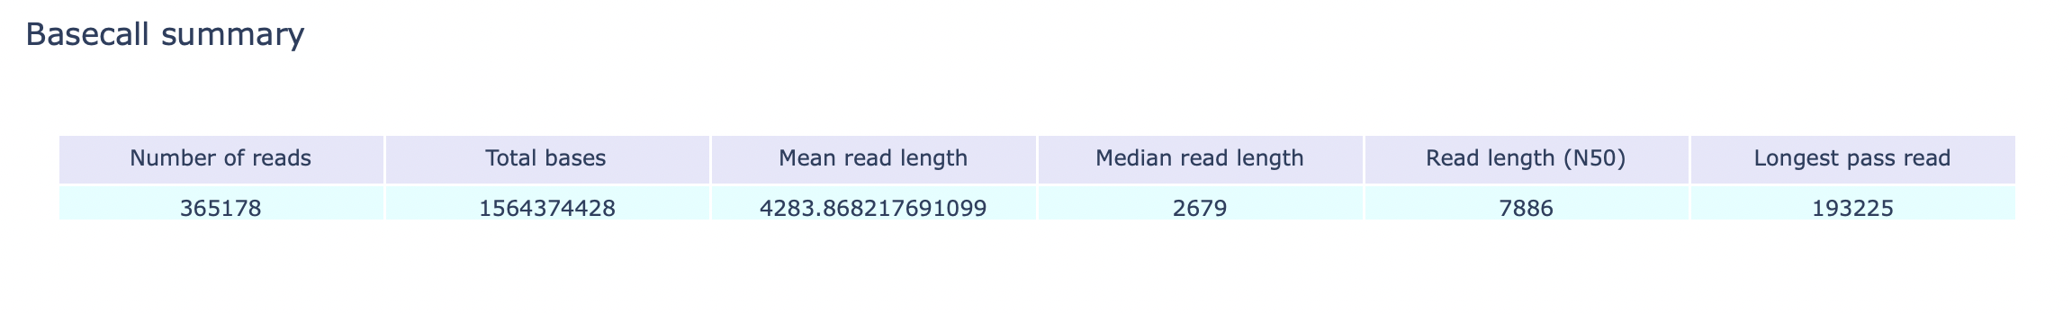
01
Read Length
Part 2: Make table with Plotly (plotly.graph_objects)
By Mattika
Python code:
Output:
12

Slide 13
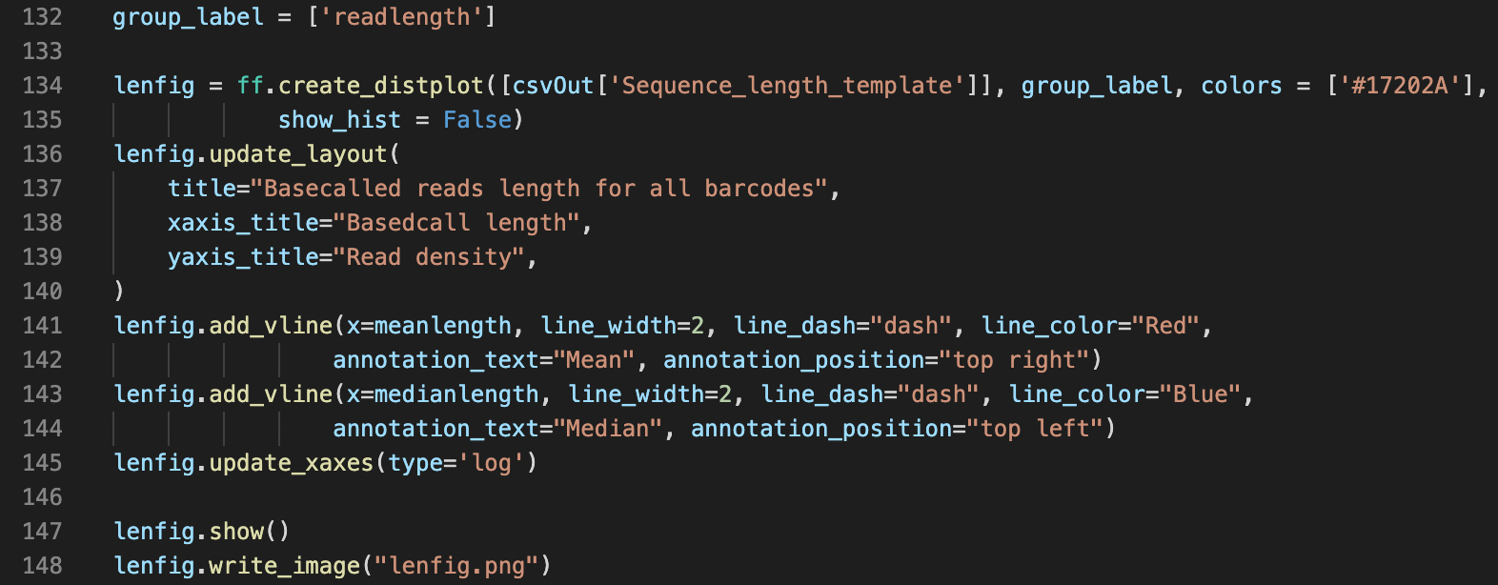
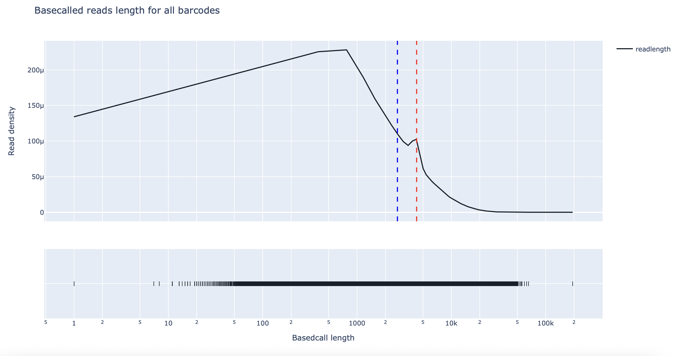
01
Read Length
Part 3: Make graph for all barcodes with Plotly (plotly.figure_factory)
By Mattika
Python code:
Output:
13

Slide 14
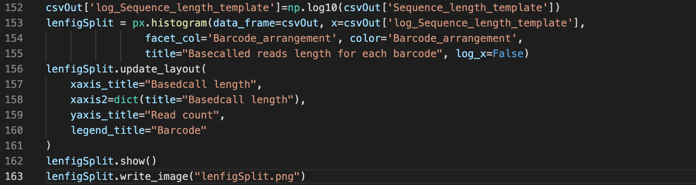
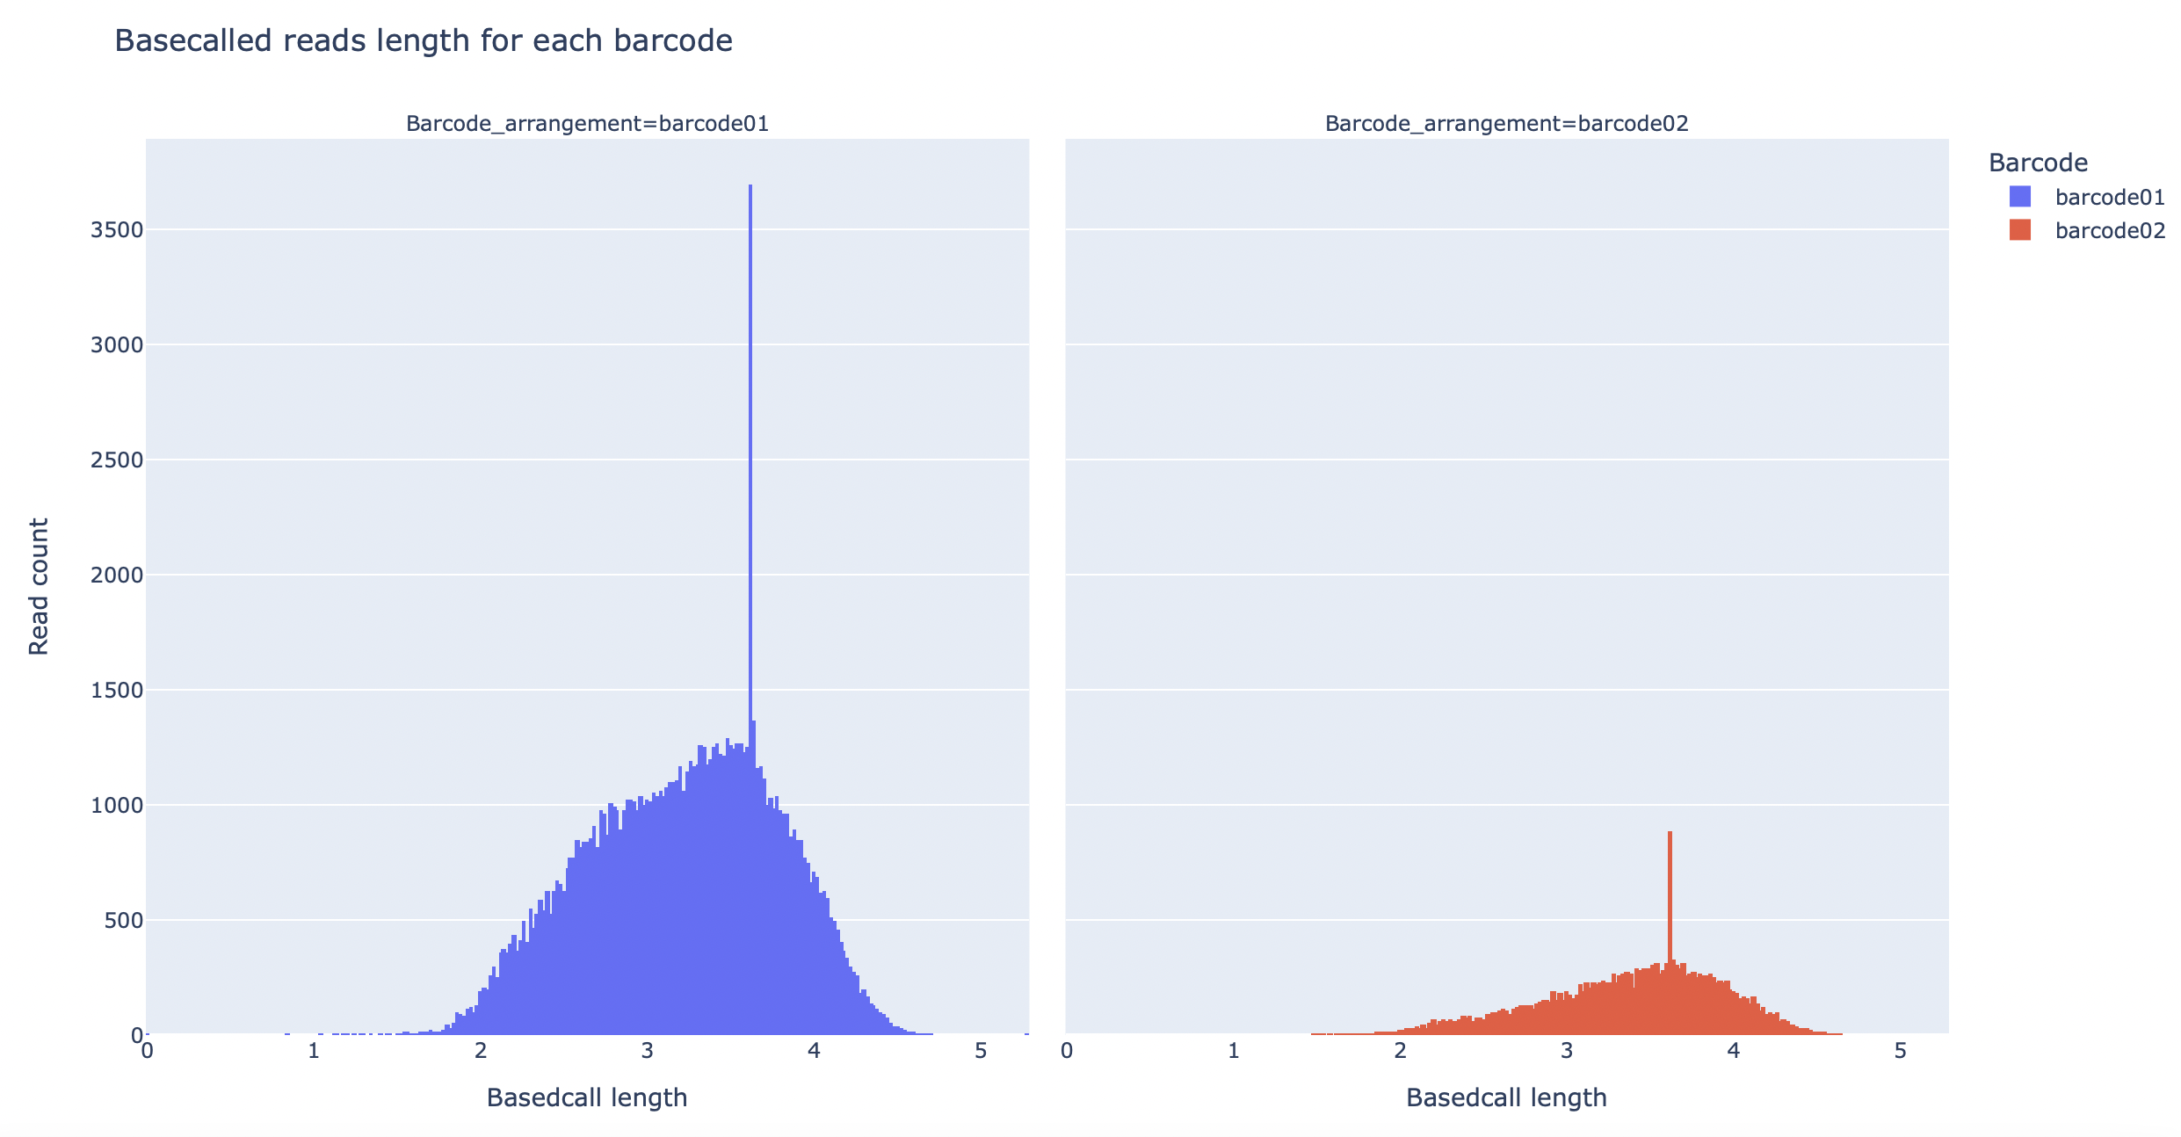
01
Read Length
Part 4: Make graph for each barcode with Plotly (plotly.express)
By Mattika
Python code:
Output:
14

Slide 15
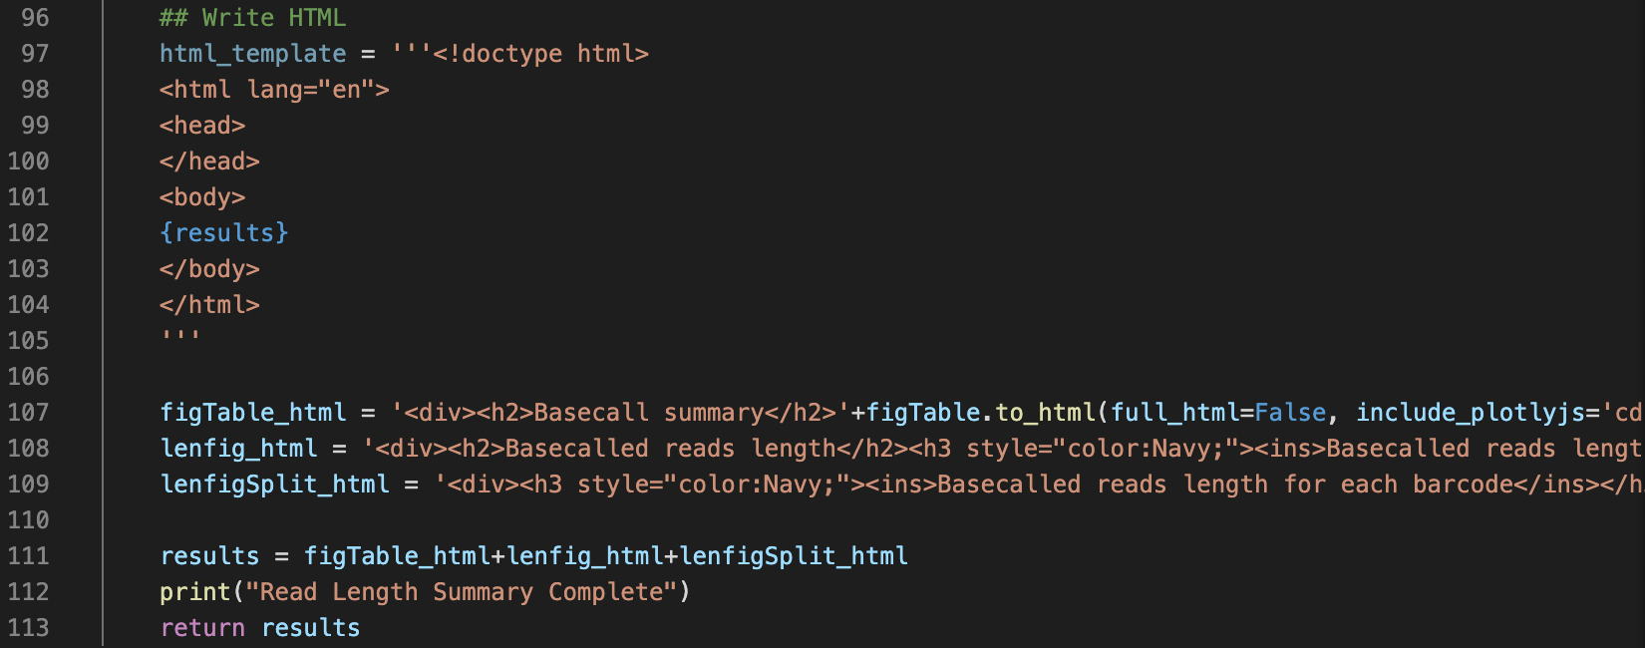
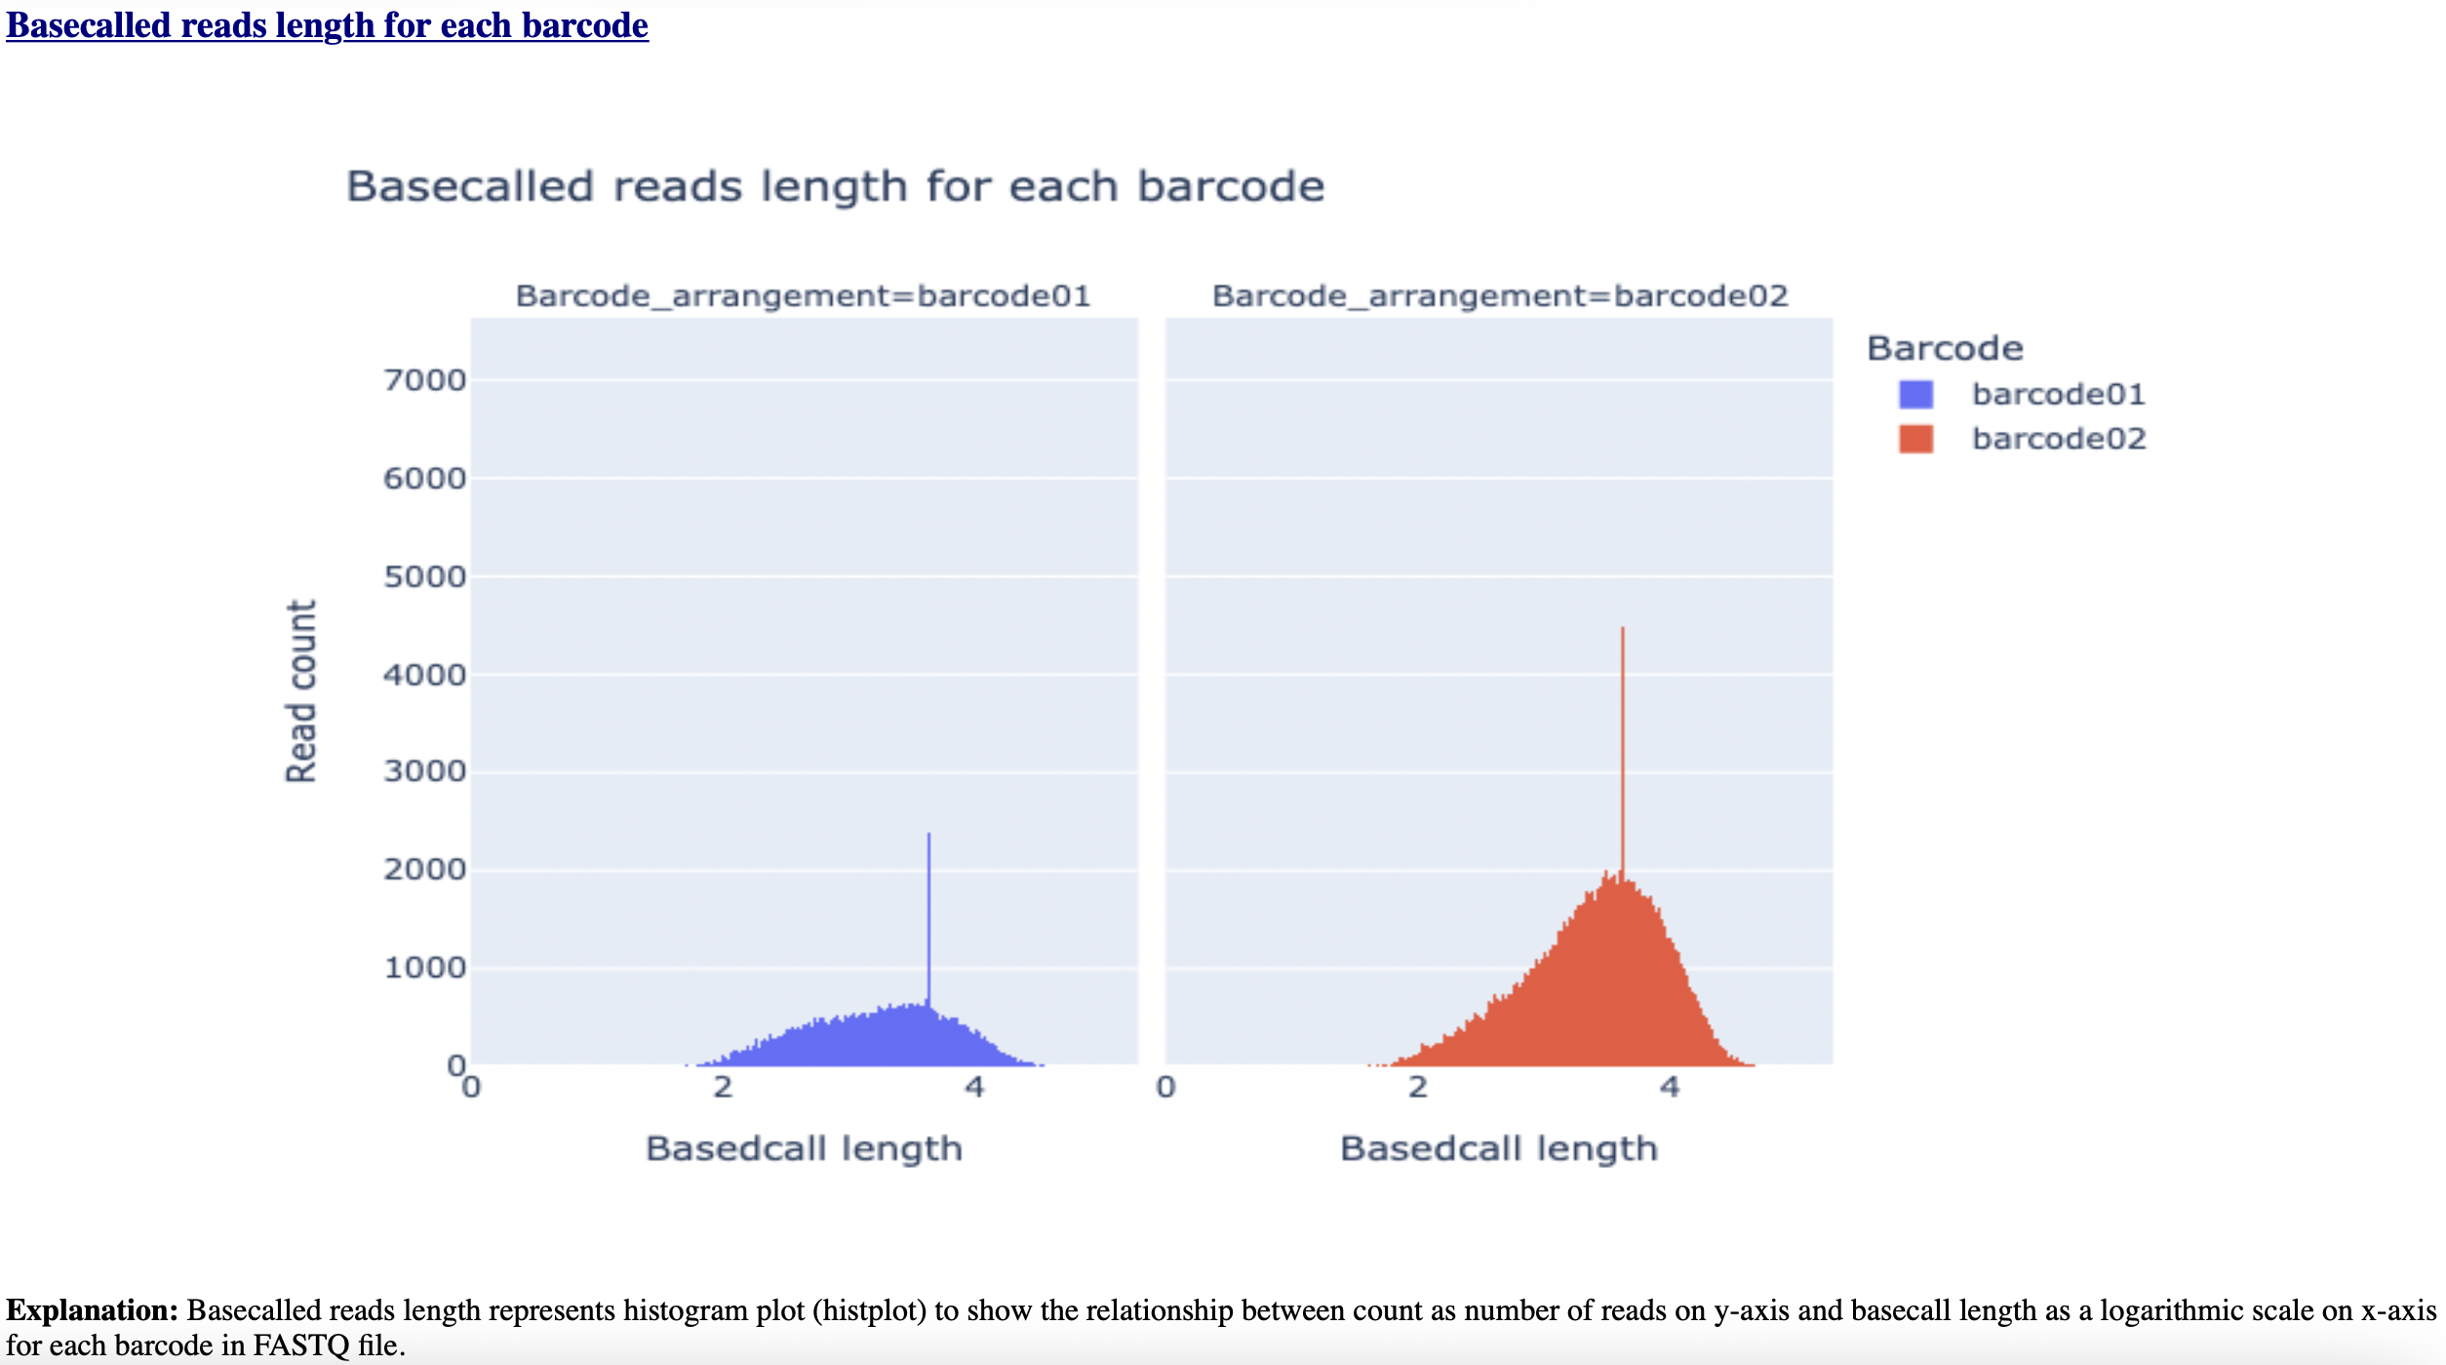
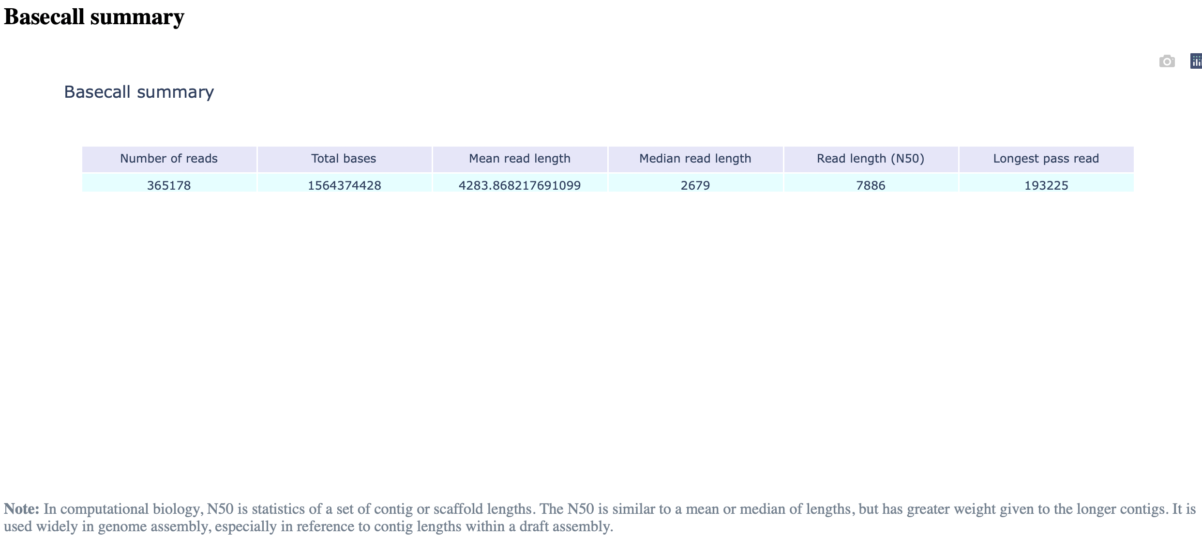
01
Read Length
Part 5: Write HTML
By Mattika
Python code:
Output:
15

Slide 16
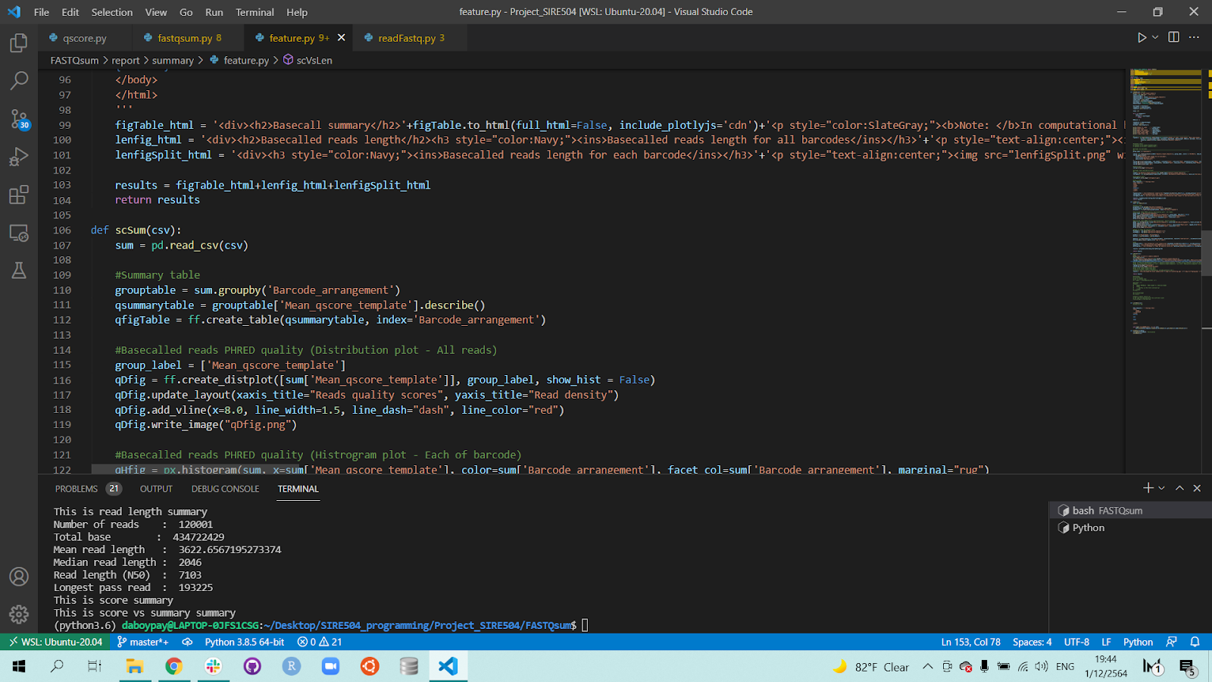
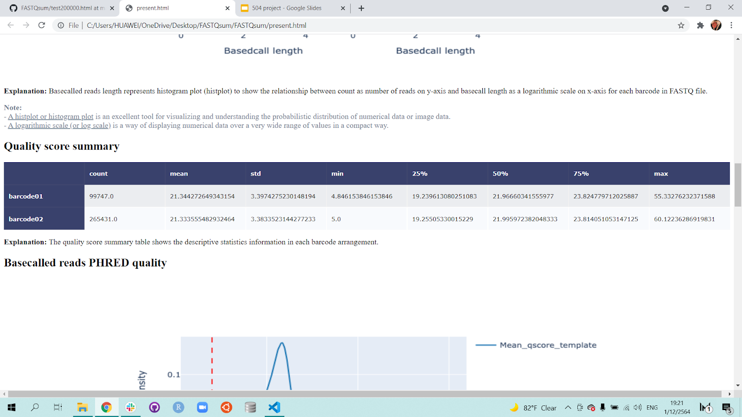
02
Quality Score
Part 1: Make the summary table
By Bowornpol
Python code:
Output:
16

Slide 17
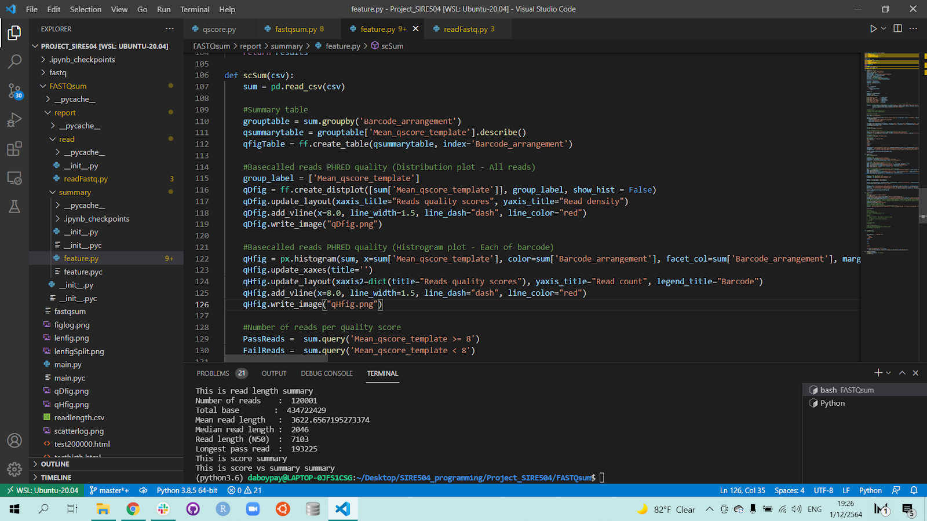
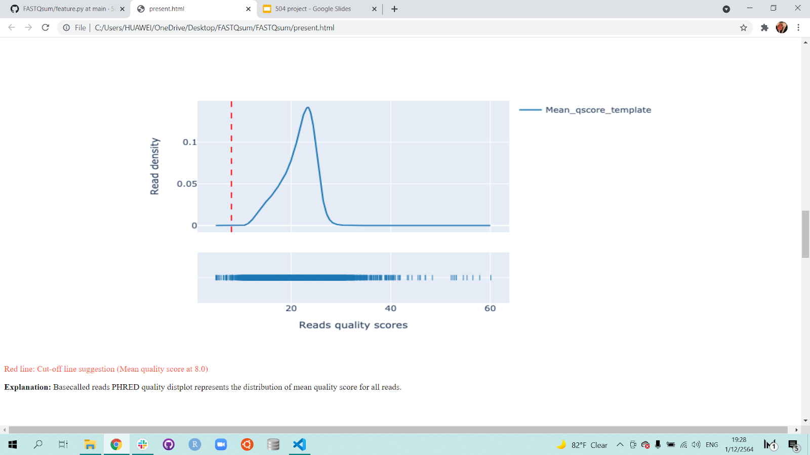
02
Quality Score
Part 2: Make the distribution plot for all reads
By Bowornpol
Python code:
Output:
17

Slide 18
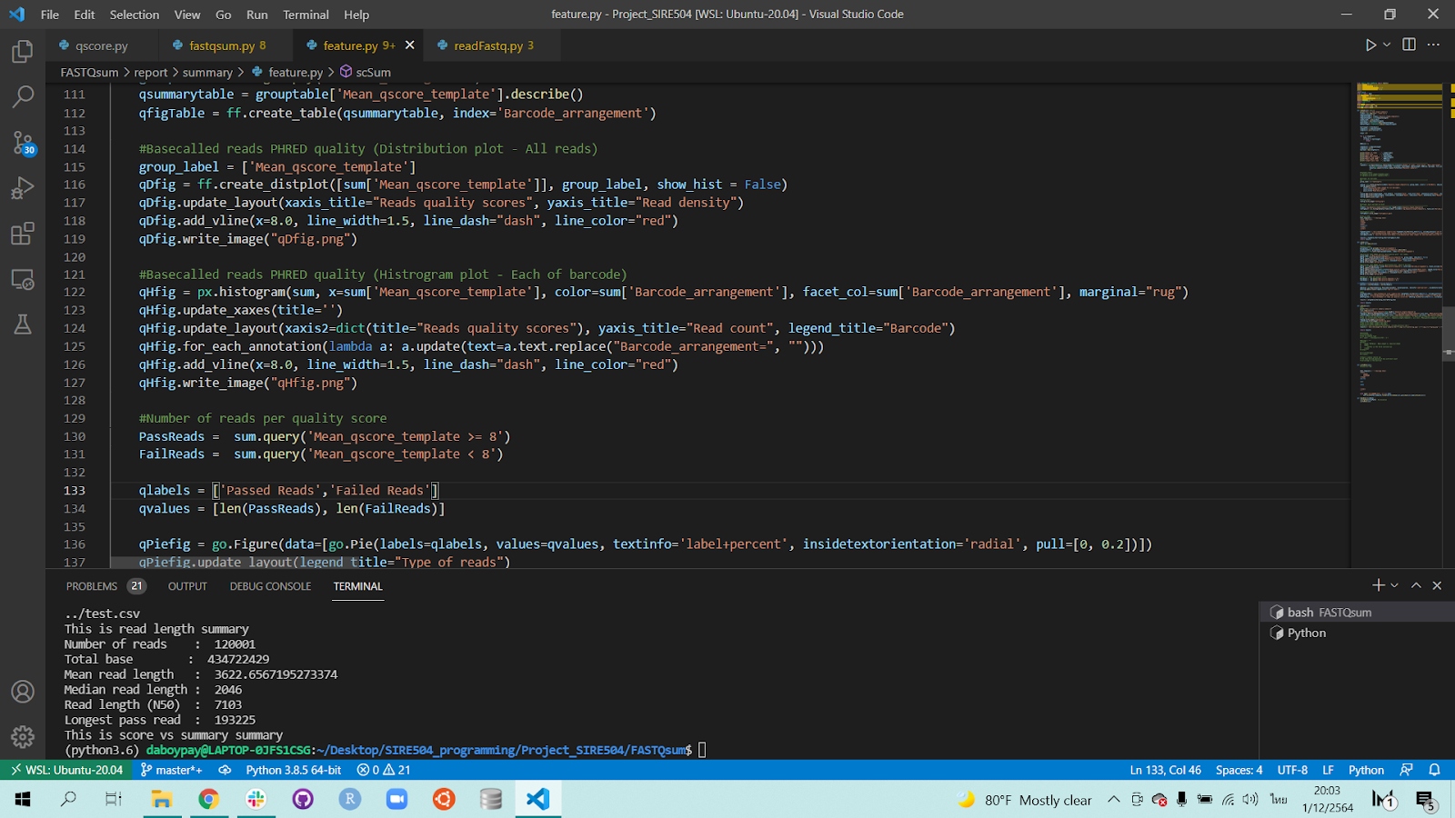
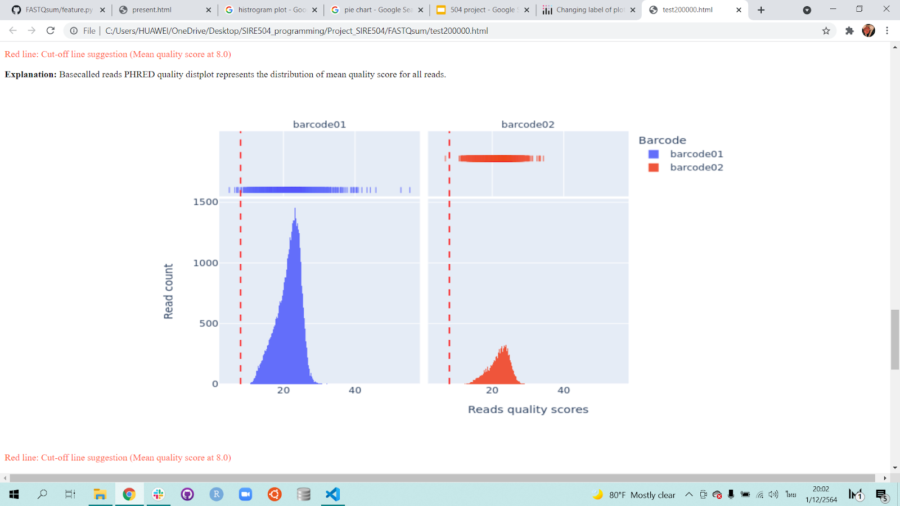
02
Quality Score
Part 3: Make the histogram plot to visualize data in each barcode arrangement
By Bowornpol
Python code:
Output:
18

Slide 19
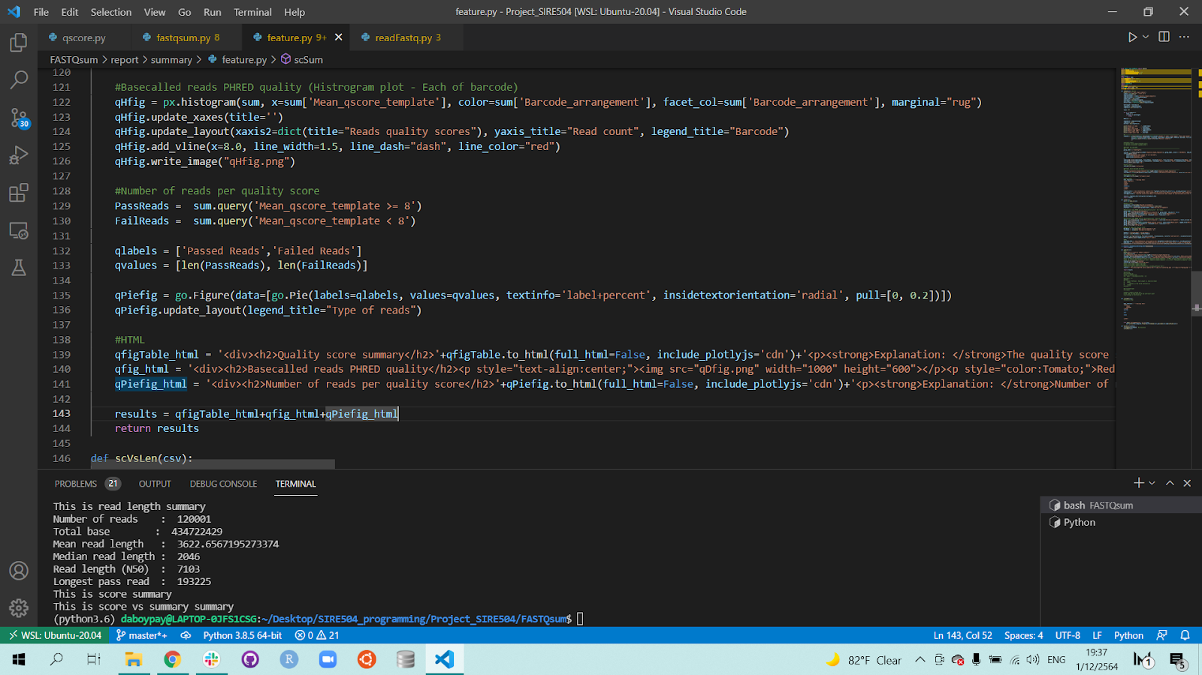
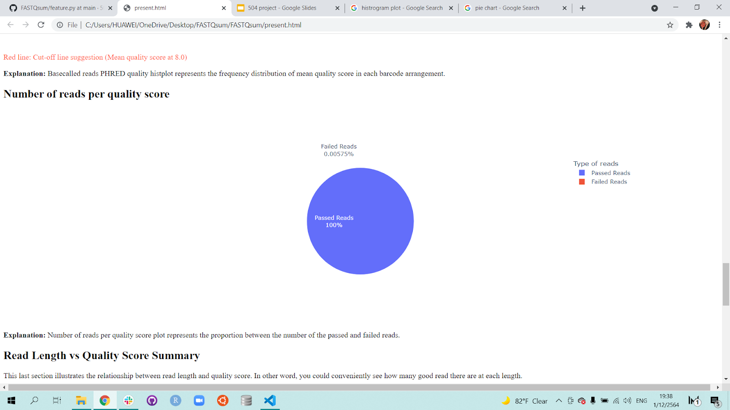
02
Quality Score
Part 4: Make a pie chart of the number of reads per quality score
By Bowornpol
Python code:
Output:
19

Slide 20
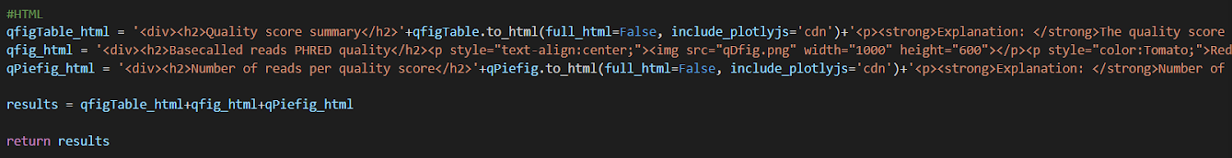
02
Quality Score
Part 5: Write the content division element for HTML
By Bowornpol
Python code:
Output:
20

Slide 21
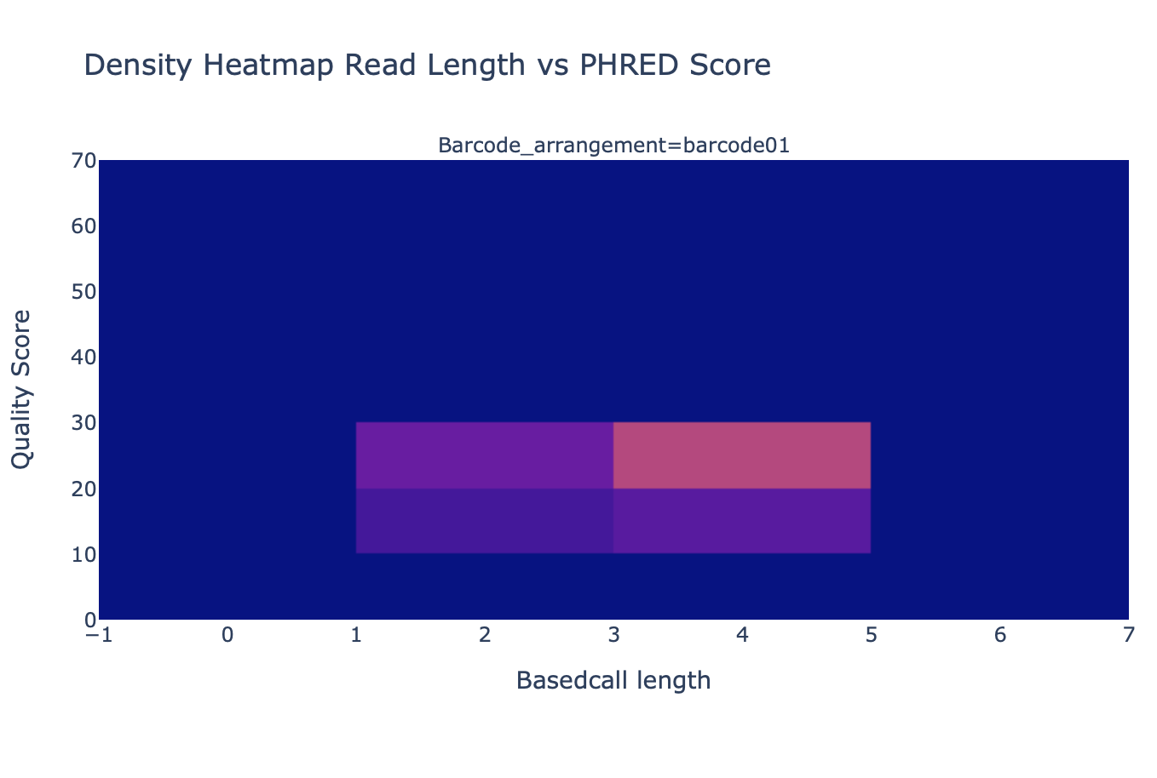
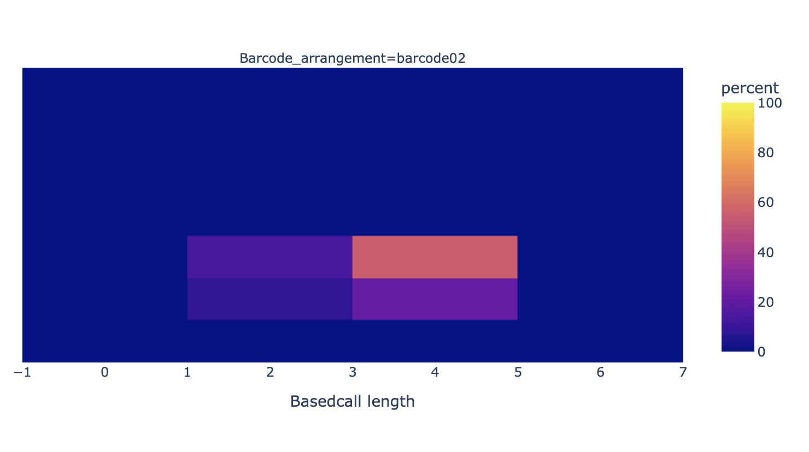
03
Quality vs. Read length
By Naphat
Heatmap
heatlog=px.density_heatmap(data_frame=c,x=c.loc[:,'log_Sequence_length_template'],y=c.loc[:,'Mean_qscore_template'],facet_row='Barcode_arrangement',nbinsx=5,nbinsy=10,title='Density Heatmap Read Length vs PHRED Score')
Heatmap are generated by Plotly Express heatmap
5 bin in x-axis (length)
10 bin in y-axis (score)
Yellow = high density
Purple = low density
21

Slide 22
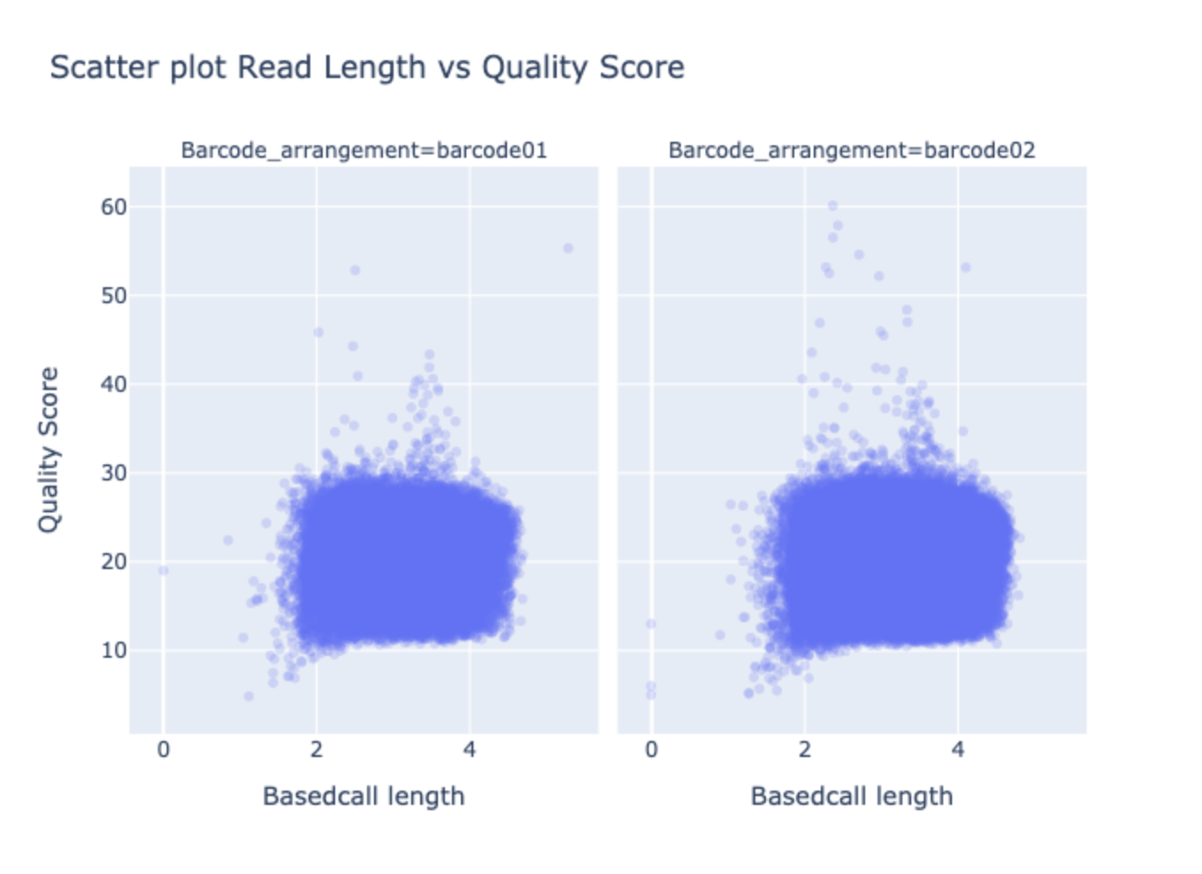
03
Quality vs. Read length
By Naphat
Scatter plot
scatterlog=px.scatter(data_frame=c,x=c.loc[:,'log_Sequence_length_template’],y=c.loc[:,'Mean_qscore_template'],facet_row='Barcode_arrangement',opacity=0.2,title='Scatter plot Read Length vs Quality Score’)
Scatter plot generated by plotly express scatter
point opacity = 0.2 to show when point overlap
22

